Slide 1
WILEY
IFRS EDITION
Prepared by
Coby Harmon
University of California, Santa Barbara
Westmont College

Slide 2
PREVIEW OF CHAPTER 10
Financial Accounting
IFRS 3rd Edition
Weygandt ● Kimmel ● Kieso

Slide 3
CHAPTER
10
Liabilities
LEARNING OBJECTIVES
After studying this chapter, you should be able to:
Explain a current liability, and identify the major types of current liabilities.
Describe the accounting for notes payable.
Explain the accounting for other current liabilities.
Explain why bonds are issued, and identify the types of bonds.
Prepare the entries for the issuance of bonds and interest expense.
Describe the entries when bonds are redeemed.
Describe the accounting for long-term notes payable.
Identify the methods for the presentation and analysis of non-current liabilities.

Slide 4
Current Liabilities
Learning Objective 1
Explain a current liability, and identify the major types of current liabilities.
What Is a Current Liability?
A debt that a company expects to pay
from existing current assets or through the creation of other current liabilities, and
within one year or the operating cycle, whichever is longer.
Current liabilities include notes payable, accounts payable, unearned revenues, and accrued liabilities such as taxes, salaries and wages, and interest payable.
LO 1

Slide 5
What Is a Current Liability?
Question
The time period for classifying a liability as current is one year or the operating cycle, whichever is:
Longer
Shorter
Probable
possible
LO 1

Slide 6
Notes Payable
Learning Objective 2
Describe the accounting for notes payable.
Written promissory note.
Usually require the borrower to pay interest.
Frequently issued to meet short-term financing needs.
Issued for varying periods of time.
Those due for payment within one year of the balance sheet date are usually classified as current liabilities.
LO 2

Slide 7
Notes Payable
Illustration: Hong Kong National Bank agrees to lend HK$100,000 on September 1, 2017, if C.W. Co. signs a HK$100,000, 12%, four-month note maturing on January 1.
Instructions
Prepare the journal entry on September 1.
Prepare the adjusting journal entry on December 31, assuming monthly adjusting entries have not been made.
Prepare the journal entry at maturity (January 1, 2018).
LO 2

Slide 8
Notes Payable
Illustration: Hong Kong National Bank agrees to lend HK$100,000 on September 1, 2017, if C.W. Co. signs a HK$100,000, 12%, four-month note maturing on January 1.
a) Prepare the journal entry on September 1.
Cash 100,000
Notes Payable 100,000
b) Prepare the adjusting journal entry on Dec. 31.
Interest Expense 4,000
Interest Payable 4,000
HK$100,000 x 12% x 4/12 = HK$4,000
LO 2

Slide 9
Notes Payable
Illustration: Hong Kong National Bank agrees to lend HK$100,000 on September 1, 2017, if C.W. Co. signs a HK$100,000, 12%, four-month note maturing on January 1.
c) Prepare the journal entry at maturity (January 1, 2018).
Notes Payable 100,000
Interest Payable 4,000
Cash 104,000
LO 2

Slide 10
Sales Taxes Payable
Learning Objective 3
Explain the accounting for other current liabilities.
Sales taxes are expressed as a stated percentage of the sales price.
Selling company
collects tax from the customer.
remits the collections to the government’s department of revenue.
LO 3

Slide 11
Sales Taxes Payable
Illustration: The March 25 cash register reading for Cooley Grocery shows sales of NT$10,000 and sales taxes of NT$600 (sales tax rate of 6%), the journal entry is:
Cash 10,600
Sales Revenue 10,000
Sales Tax Payable 600
LO 3

Slide 12
Sales Taxes Payable
Sometimes companies do not ring up sales taxes separately on the cash register.
Illustration: Cooley Grocery rings up total receipts of NT$10,600. Because the amount received from the sale is equal to the sales price 100% plus 6% of sales, (sales tax rate of 6%), the journal entry is:
Mar. 25
Cash 10,600
Sales Revenue 10,000
*
Sales Taxes Payable 600
* NT$10,600 ÷ 1.06 = NT$10,000
LO 3

Slide 13
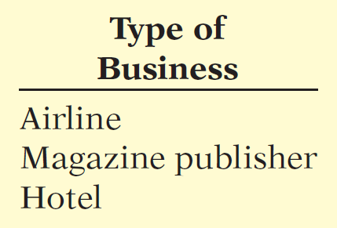
Unearned Revenues
Revenues that are received before goods are delivered or services are performed.
Company increases (debits) Cash and increases (credits) a current liability account, Unearned Revenue.
When the company recognizes revenue, it decreases (debits) the unearned revenue account and increases (credits) a revenue account.
LO 3

Slide 14
Unearned Revenues
Illustration: Busan IPark (KOR) sells 10,000 season football tickets at W 50,000 each for its five-game home schedule. The club makes the following entry for the sale of season tickets (in thousands of W):
Aug. 6
Cash 500,000
Unearned Ticket Revenue 500,000
As each game is completed, Busan IPark records the revenue earned.
Sept. 7
Unearned Ticket Revenue 100,000
Ticket Revenue 100,000
LO 3

Slide 15
Current Maturities of Long-term Debt
Portion of long-term debt that comes due in the current year.
No adjusting entry required.
Illustration: Wendy Construction issues a five-year, interest-bearing €25,000 note on January 1, 2017. This note specifies that each January 1, starting January 1, 2018, Wendy should pay €5,000 of the note. When the company prepares financial statements on December 31, 2017,
What amount should be reported as a current liability? __________
What amount should be reported as a long-term liability? ________
€5,000
€20,000
LO 3

Slide 16
>
DO IT!
You and several classmates are studying for the next accounting examination. They ask you to answer the following questions.
If cash is borrowed on a $50,000, 6-month, 12% note on September 1, how much interest expense would be incurred by December 31?
The cash register total including sales taxes is $23,320, and the sales tax rate is 6%. What is the sales taxes payable?
If $15,000 is collected in advance on November 1 for 3 months’ rent, what amount of rent revenue should be recognized by December 31?
$50,000 × 12% × 4/12 = $2,000
$23,320 ÷ 1.06 = $22,000; $23,320 − $22,000 = $1,320
$15,000 × 2/3 = $10,000
LO 3

Slide 17
Statement Presentation and Analysis
PRESENTATION
Current liabilities are presented after non-current liabilities on the statement of financial position.
A common method of presenting current liabilities is to list them by order of magnitude, with the largest ones first.
LO 3

Slide 18
Statement Presentation and Analysis
Illustration 10-3
Statement of financial position presentation of current liabilities (in thousands)
LO 3

Slide 19
Statement Presentation and Analysis
ANALYSIS
Illustration 10-4
Working capital formula and computation (in thousands)
Liquidity refers to the ability to pay maturing obligations and meet unexpected needs for cash.
The current ratio permits us to compare the liquidity of different-sized companies and of a single company at different times.
Illustration 10-5
Current ratio formula and computation (in thousands)
LO 3

Slide 20
Non-Current Liabilities
Learning Objective 4
Explain why bonds are issued, and identify the types of bonds.
Obligations that are expected to be paid more than one year in the future.
Bond Basics
A form of interest-bearing notes payable.
To obtain large amounts of long-term capital.
Three advantages over ordinary shares:
Shareholder control is not affected.
Tax savings result.
Earnings per share may be higher.
LO 4

Slide 21
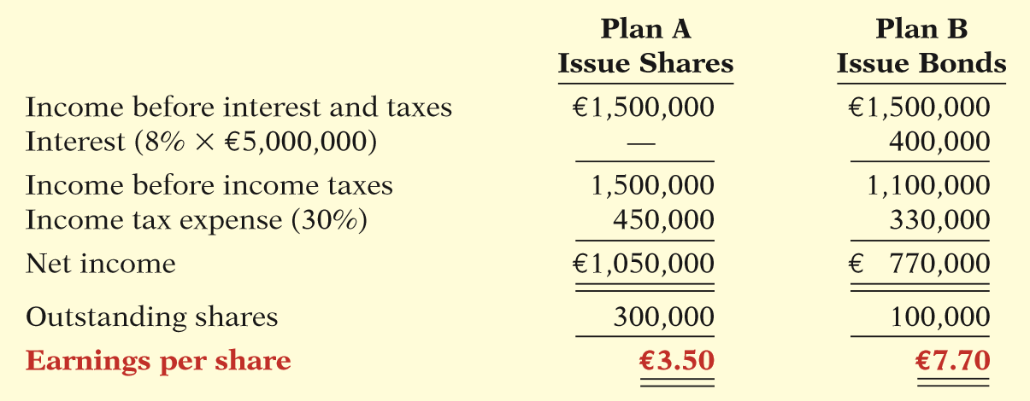
Bond Basics
Effects on earnings per share—equity vs. debt.
Illustration 10-7
Effects on earnings per share—equity vs. debt
LO 4

Slide 22
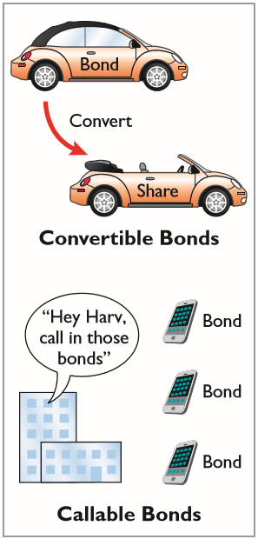
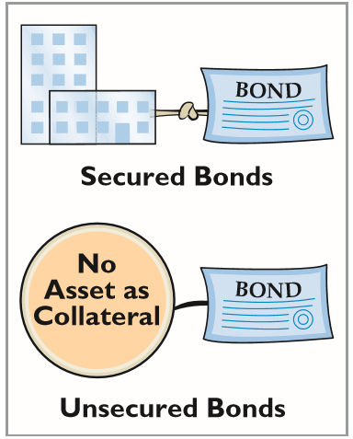
Bond Basics
TYPES OF BONDS
LO 4

Slide 23
Bond Basics
ISSUING PROCEDURES
Government laws grant corporations power to issue bonds.
Board of directors and shareholders must approve bond issues.
Board of directors must stipulate number of bonds to be authorized, total face value, and contractual interest rate.
Terms of the bond are set forth in a legal document called a bond indenture.
LO 4

Slide 24
Bond Basics
ISSUING PROCEDURES
Represents a promise to pay:
face value at designated maturity date, plus
periodic interest at a contractual (stated) interest rate on the maturity amount (face value).
Interest payments usually made semiannually.
Generally issued when the amount of capital needed is too large for one lender to supply.
LO 4

Slide 25
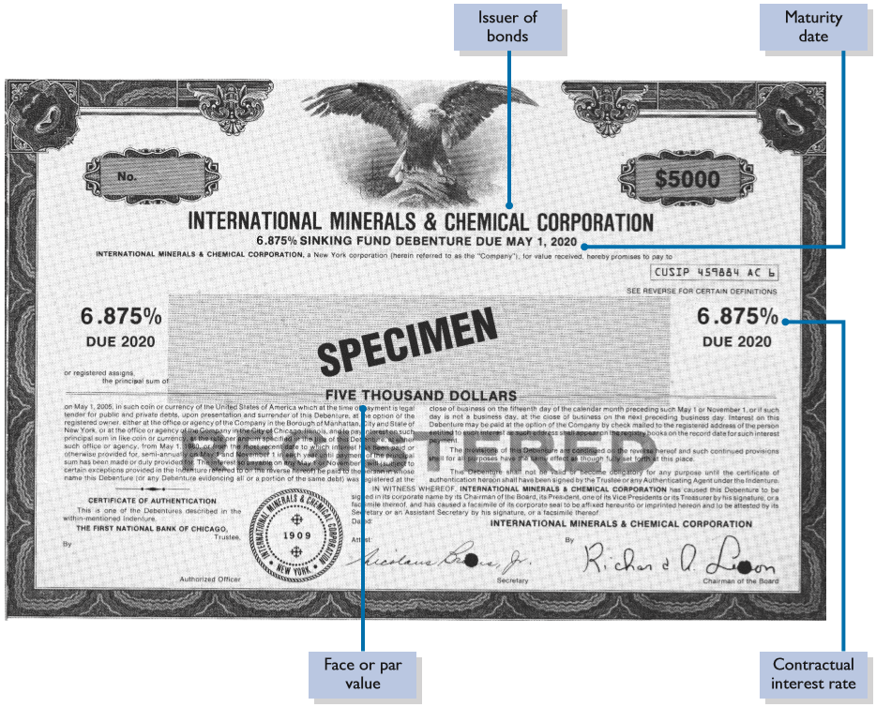
Illustration 10-8
Bond certificate
LO 4

Slide 26
Bond Basics
BOND TRADING
Bondholders can sell their bonds, at any time, at the current market price on national securities exchanges.
Bond prices are quoted as a percentage of the face value.
Newspapers and the financial press publish bond prices and trading activity daily.
Illustration 10-9
Market information for bonds
LO 4

Slide 27
Bond Basics
BOND TRADING
Bondholders can sell their bonds, at any time, at the current market price on national securities exchanges.
Bond prices are quoted as a percentage of the face value.
Newspapers and the financial press publish bond prices and trading activity daily.
A corporation makes journal entries only when it issues or buys back bonds, or when bondholders exchange convertible bonds into ordinary shares.
LO 4

Slide 28
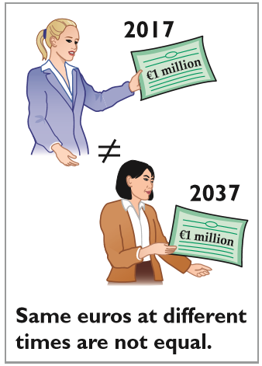
Determining the Market Price of a Bond
The current market price (present value) of a bond is a function of three factors:
the dollar amounts to be received,
the length of time until the amounts are received, and
the market rate of interest.
The process of finding the present value is referred to as discounting the future amounts.
LO 4

Slide 29
Determining the Market Price of a Bond
Illustration: Assume that Acropolis SA on January 1, 2017, issues €100,000 of 9% bonds, due in five years, with interest payable annually at year-end.
Illustration 10-10
Time diagram depicting cash flows
Illustration 10-11
Computing the market price of bonds
LO 4

Slide 30
People, Planet, and Profit Insight
How About Some Green Bonds?
Unilever (GBR and NLD) recently began producing popular frozen treats such as Magnums and Cornettos, funded by green bonds. Green bonds are debt used to fund activities such as renewable-energy projects. In Unilever’s case, the proceeds from the sale of green bonds are used to clean up the company’s manufacturing operations and cut waste (such as related to energy consumption). The use of green bonds has taken off as companies now have guidelines as to how to disclose and report on these green-bond proceeds. These standardized disclosures provide transparency as to how these bonds are used and their effect on overall profitability. Investors are taking a strong interest in these bonds. Investing companies are installing socially responsible investing teams and have started to integrate sustainability into their investment processes. The disclosures of how companies are using the bond proceeds help investors to make better financial decisions.
Source: Ben Edwards, “Green Bonds Catch On.” Wall Street Journal (April 3, 2014), p. C5.
LO 4

Slide 31
>
DO IT!
Indicate whether each of the following statements is true or false.
Mortgage bonds and sinking fund bonds are both examples of secured bonds.
Unsecured bonds are also known as debenture bonds.
The stated rate is the rate investors demand for loaning funds.
The face value is the amount of principal the issuing company must pay at the maturity date.
The bond issuer must make journal entries to record transfers of its bonds among investors.
True
True
False
True
False
LO 4

Slide 32
Accounting for Bond Issues
Learning Objective 5
Prepare the entries for the issuance of bonds and interest expense.
A corporation records bond transactions
when it
issues (sells) or redeems (buys back) bonds and
when bondholders convert bonds into ordinary shares.
Bonds may be issued at
face value,
below face value (discount), or
above face value (premium).
Bond prices are quoted as a percentage of face value.
LO 5

Slide 33
ISSUING BONDS AT FACE VALUE
Illustration: On January 1, 2017, Candlestick AG issues €100,000, five-year, 10% bonds at 100 (100% of face value). The entry to record the sale is:
Jan. 1
Cash 100,000
Bonds Payable 100,000
Prepare the entry Candlestick would make to accrue interest on December 31 (€100,000 x 10%).
Dec. 31
Interest Expense 10,000
Interest Payable 10,000
LO 5

Slide 34
ISSUING BONDS AT FACE VALUE
Prepare the entry Candlestick would make to pay the interest on Jan. 1, 2018.
Jan. 1
Interest Payable 10,000
Cash 10,000
LO 5

Slide 35
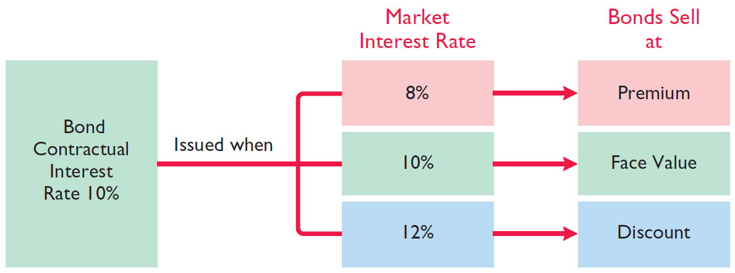
DISCOUNT OR PREMIUM ON BONDS
Issue at Par, Discount, or Premium?
Illustration 10-12
Interest rates and bond prices
LO 5

Slide 36
Accounting for Bond Issues
Question
Karson Ltd. issues 10-year bonds with a maturity value of £200,000. If the bonds are issued at a premium, this indicates that:
the contractual interest rate exceeds the market interest rate.
the market interest rate exceeds the contractual interest rate.
the contractual interest rate and the market interest rate are the same.
no relationship exists between the two rates.
LO 5

Slide 37
ISSUING BONDS AT A DISCOUNT
Illustration: Assume that on January 1, 2017, Candlestick AG sells €100,000, five-year, 10% bonds for €98,000 (98% of face value). Interest is payable annually on January 1. The entry to record the issuance is as follows.
Jan. 1
Cash 98,000
Bonds Payable 98,000
LO 5

Slide 38
ISSUING BONDS AT A DISCOUNT
Statement Presentation
Illustration 10-13
Statement presentation of discount on bonds payable
The issuance of bonds below face value—at a discount—causes the total cost of borrowing to differ from the bond interest paid.
The issuing company must pay not only the contractual interest rate over the term of the bonds but also the face value (rather than the issuance price) at maturity.
LO 5

Slide 39
Total Cost of Borrowing
Illustration 10-14
Computation of total cost
of borrowing—bonds issued at discount
Illustration 10-15
Alternative computation of total cost of borrowing—bonds issued at discount
LO 5

Slide 40
ISSUING BONDS AT A DISCOUNT
Amortization of bond discount:
Allocated to expense in each period.
Increases the amount of interest expense reported each period.
Amount of interest expense reported each period will exceed the contractual amount paid.
As the discount is amortized, its balance declines.
The carrying value of the bonds will increase, until at maturity the carrying value of the bonds equals their face amount.
LO 5

Slide 41
ISSUING BONDS AT A PREMIUM
Illustration: Assume that the Candlestick AG bonds previously described sell for €102,000 (102% of face value) rather than for €98,000. The entry to record the sale is as follows:
Jan. 1
Cash 102,000
Bonds Payable 102,000
LO 5

Slide 42
ISSUING BONDS AT A PREMIUM
Statement Presentation
Illustration 10-17
Statement presentation of bonds issued at a premium
Sale of bonds above face value causes the total cost of borrowing to be less than the bond interest paid.
The borrower is not required to pay the bond premium at the maturity date of the bonds. Thus, the bond premium is considered to be a reduction in the cost of borrowing.
LO 5

Slide 43
Total Cost of Borrowing
Illustration 10-18
Total cost of borrowing—bonds issued at a premium
Illustration 10-19
Alternative computation of total cost of borrowing—bonds issued at a premium
LO 5

Slide 44
ISSUING BONDS AT A PREMIUM
Amortization of bond premium:
Allocated to expense in each period.
Decreases the amount of interest expense reported each period.
Amount of interest expense reported each period will be less than the contractual amount paid.
As the premium is amortized, its balance declines.
The carrying value of the bonds will decrease, until at maturity the carrying value of the bonds equals their face amount.
LO 5

Slide 45
>
DO IT!
Giant Ltd. issues ¥200,000,000 of bonds for ¥189,000,000.
(a) Prepare the journal entry to record the issuance of the bonds, and (b) show how the bonds would be reported on the statement of financial position at the date of issuance.
(a)
Cash 189,000,000
Bonds Payable 189,000,000
(b)
Non-current liabilities
Bonds payable ¥189,000,000
LO 5

Slide 46
REDEEMING BONDS AT MATURITY
Learning Objective 6
Describe the entries when bonds are redeemed.
Candlestick AG records the redemption of its bonds at maturity as follows:
Bonds Payable 100,000
Cash 100,000
LO 6

Slide 47
REDEEMING BONDS BEFORE MATURITY
When a company retires bonds before maturity, it is necessary to:
eliminate the carrying value of the bonds at the redemption date;
record the cash paid; and
recognize the gain or loss on redemption.
The carrying value of the bonds is the face value of the bonds less unamortized bond discount or plus unamortized bond premium at the redemption date.
LO 6

Slide 48
REDEEMING BONDS BEFORE MATURITY
Illustration: Assume at the end of the fourth period, Candlestick AG having sold its bonds at a premium, retires the bonds at 103 after paying the annual interest. Assume that the carrying value of the bonds at the redemption date is €100,476. Candlestick records the redemption at the end of the fourth interest period (January 1, 2021) as follows:
Jan. 1
Bonds Payable 100,476
Loss on Bond Redemption 2,524
Cash 103,000
LO 6

Slide 49
>
DO IT!
R & B Inc. issued £500,000, 10-year bonds at a discount. Prior to maturity, when the carrying value of the bonds is £496,000, the company redeems the bonds at 98. Prepare the entry to record the redemption of the bonds.
Solution
There is a gain on redemption. The cash paid, £490,000 (£500,000 × 98%), is less than the carrying value of £496,000. The entry is:
Bonds Payable 496,000
Gain on Bond Redemption 6,000
Cash 490,000
LO 6

Slide 50
Accounting for Long-Term Notes Payable
Learning Objective 7
Describe the accounting for long-term notes payable.
May be secured by a mortgage that
pledges title to specific assets as
security for a loan.
Typically, the terms require the borrower to make installment payments over the term of the loan. Each payment consists of
interest on the unpaid balance of the loan and
a reduction of loan principal.
Companies initially record mortgage notes payable at face value.
LO 7

Slide 51
Accounting for Long-Term Notes Payable
Illustration: Mongkok Technology Ltd. issues a HK$500,000, 8%, 20-year mortgage note on December 31, 2017. The terms provide for annual installment payments of HK$50,926.
Illustration 10-21
Mortgage installment payment schedule
LO 7

Slide 52
Accounting for Long-Term Notes Payable
Illustration: Mongkok records the mortgage loan and first installment payment as follows:
Dec. 31
Cash 500,000
Mortgage Payable 500,000
Dec. 31
Interest Expense 40,000
Mortgage Payable 10,926
Cash 50,926
LO 7

Slide 53
Accounting for Long-Term Notes Payable
Question
Howard Ltd. issued a 20-year mortgage note payable on January 1, 2017. At December 31, 2017, the unpaid principal balance will be reported as:
a current liability.
a non-current liability.
part current and part non-current liability.
interest payable.
LO 7

Slide 54
Accounting Across the Organization
Bonds versus Notes?
Companies have a choice in the form of long-term borrowing they undertake—issue bonds or issue notes. Notes are generally issued to a single lender (usually through a loan from a bank). Bonds, on the other hand, allow the company to divide the borrowing into many small investing units, thereby enabling more than one investor to participate in the borrowing. U.S. companies are recently borrowing more from bond investors than from banks and other loan providers in a bid to lock in cheap, long-term funding. Why this trend? For one thing, low interest rates and rising inflows into fixed-income funds have triggered record bond issuances as banks cut back lending. In addition, for some high-rated companies, it can be riskier to borrow from a bank than the bond markets. The reason: High-rated companies tended to rely on short-term financing to fund working capital but were left stranded when these markets froze up. Some are now financing themselves with longer-term bonds instead.
Source: A. Sakoui and N. Bullock, “Companies Choose Bonds for Cheap Funds,” Financial Times (October 12, 2009).
LO 7

Slide 55
>
DO IT!
Cole Research issues a ₩250,000,000, 6%, 20-year mortgage note to obtain needed financing for a new lab. The terms call for annual payments of ₩21,796,000 each. Prepare the entries to record the mortgage loan and the first installment payment.
Solution
Cash 250,000,000
Mortgage Payable 250,000,000
Interest Expense 15,000,000*
Mortgage Payable 6,796,000
Cash 21,796,000
*Interest expense = ₩250,000,000 × 6%.
LO 7

Slide 56
Statement Presentation and Analysis
Learning Objective 8
Identify the methods for the presentation and analysis of non-current liabilities
PRESENTATION
Illustration 10-22
Statement of financial position presentation of non-current liabilities
LO 8

Slide 57
Statement Presentation and Analysis
ANALYSIS
Two ratios that provide information about debt-paying ability and long-run solvency are:
Debt to Total Assets Ratio
Times Interest Earned Ratio
LO 8

Slide 58
Statement Presentation and Analysis
ANALYSIS
Illustration: LG (KOR) had total liabilities of ₩22,839 billion, total assets of ₩35,528 billion, interest expense of ₩827 billion, income taxes of ₩354 billion, and net income of ₩223 billion.
Illustration 10-23
Debt to assets and times interest earned ratios, with computations (in billions)
LG has a relatively high debt to total assets percentage of 64.3%. Its interest coverage of 1.70 times might be considered low.
LO 8

Slide 59
Investor Insight
“Covenant-Lite” Debt
In many corporate loans and bond issuances, the lending agreement specifies debt covenants. These covenants typically are specific financial measures, such as minimum levels of retained earnings, cash flows, times interest earned, or other measures that a company must maintain during the life of the loan. If the company violates a covenant, it is considered to have violated the loan agreement. The creditors can then demand immediate repayment, or they can renegotiate the loan’s terms. Covenants protect lenders because they enable lenders to step in and try to get their money back before the borrower gets too deep into trouble. During the 1990s, most traditional loans specified between three to six covenants or “triggers.” In more recent years, when lots of cash was available, lenders began reducing or completely eliminating covenants from loan agreements in order to be more competitive with other lenders. When the economy declined, lenders lost big money when companies defaulted.
Source: Cynthia Koons, “Risky Business: Growth of ‘Covenant-Lite’ Debt,” Wall Street Journal (June 18, 2007), p. C2.
LO 8

Slide 60
>
DO IT!
Trout Company provides you with the following statement of financial position information as of December 31, 2017.
Non-current assets €24,200 Equity €10,700
Current assets 10,500 Non-current liabilities 16,000
Total assets €34,700 Current liabilities 8,000
Total equity and liabilities €34,700
In addition, Trout reported net income for 2017 of €14,000, income tax expense of €2,800, and interest expense of €900.
Instructions (a) Compute the debt to assets ratio for Trout for 2017.
(b) Compute the times interest earned for Trout for 2017.
(a) Debt to assets ratio is 69.2% (€24,000/€34,700).
(b) Times interest earned is 19.67 times [(€14,000 + €900 + €2,800)/€900].
LO 8

Slide 61
APPENDIX 10A
Effective-Interest Method
Learning Objective 9
Apply the effective-interest method of amortizing bond discount and bond premium.
The amortization of the discount or premium results in interest expense equal to a constant percentage of the carrying value of the bonds.
Required steps:
Compute the bond interest expense.
Compute the bond interest paid or accrued.
Compute the amortization amount.
Illustration 10A-1
Computation of amortization— effective-interest method
LO 9

Slide 62
Amortizing Bond Discount
Illustration: Candlestick AG sold €100,000, five-year, 10% bonds on January 1, 2017, for €98,000. The effective-interest rate is 10.5348% and interest is payable on Jan. 1 of each year. Prepare the bond discount amortization schedule.
LO 9

Slide 63
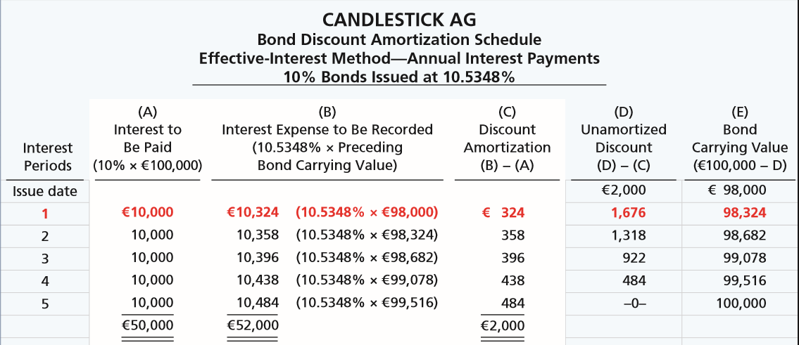
Amortizing Bond Discount
Illustration 10A-2
Bond discount amortization schedule
LO 9

Slide 64
Amortizing Bond Discount
Illustration: Candlestick AG records the accrual of interest and amortization of bond discount for the first period on Dec. 31, as follows:
Dec. 31
Interest Expense 10,324
Bonds Payable 324
Interest Payable 10,000
LO 9

Slide 65
Amortizing Bond Discount
For the second interest period, bond interest expense will be €10,358 (€98,324 × 10.5348%), and the discount amortization will be €358. At December 31, Candlestick makes the following adjusting entry.
Dec. 31
Interest Expense 10,358
Bonds Payable 358
Interest Payable 10,000
LO 9

Slide 66
Amortizing Bond Premium
Illustration: Candlestick AG sells the bonds described above for €102,000 rather than €98,000. This would result in a bond premium of €2,000 (€102,000 − €100,000). This premium results in an effective-interest rate of approximately 9.4794%.
LO 9

Slide 67
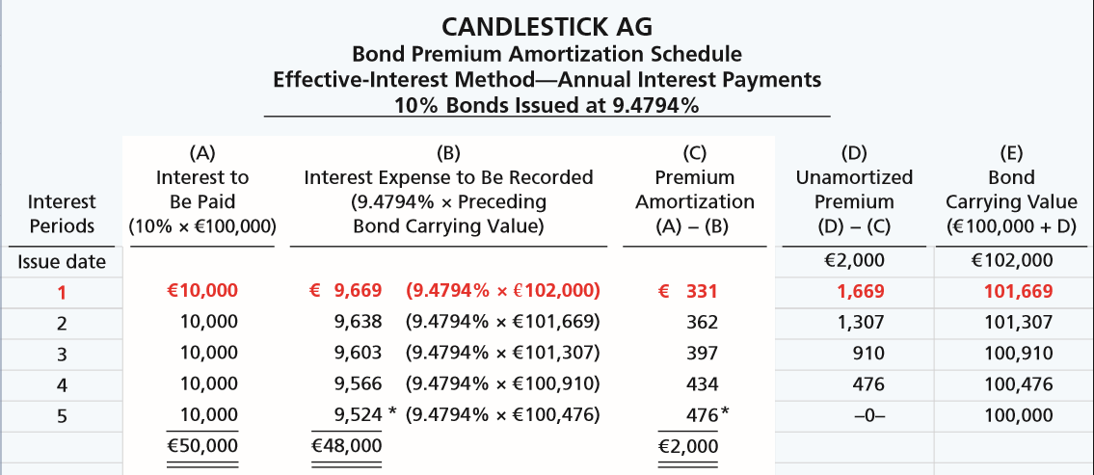
Amortizing Bond Premium
Illustration 10A-4
Bond premium amortization schedule
LO 9

Slide 68
Amortizing Bond Premium
Illustration: Candlestick AG records the accrual of interest and amortization of premium discount for the first period on Dec. 31, as follows:
Dec. 31
Interest Expense 9,669
Bonds Payable 331
Interest Payable 10,000
LO 9

Slide 69
Effective-Interest Method
Question
On January 1, Besalius plc issued £1,000,000, 9% bonds for £938,554. The market rate of interest for these bonds is 10%. Interest is payable annually on December 31. Besalius uses the effective-interest method of amortizing bond discount. At the end of the first year, Besalius should report unamortized bond discount of:
£54,900. c. £51,610.
£57,591. d. £51,000.
LO 9

Slide 70
APPENDIX 10B
Straight-Line Method
Learning Objective 10
Apply the straight-line method of amortizing bond discount and bond premium.
Amortizing Bond Discount
To follow the expense recognition principle,
companies allocate bond discount to expense
in each period in which the bonds are outstanding.
Illustration 10B-1
Formula for straight-line method of bond discount amortization
LO 10

Slide 71
Amortizing Bond Discount
Illustration: Candlestick AG sold €100,000, five-year, 10% bonds on January 1, 2017, for €98,000 (discount of €2,000). Interest is payable on January 1 of each year. Prepare the entry to accrue interest and amortize the bond discount at Dec. 31, 2017.
Dec. 31
Interest Expense 10,400
Bonds Payable 400
Interest Payable 10,000
LO 10

Slide 72
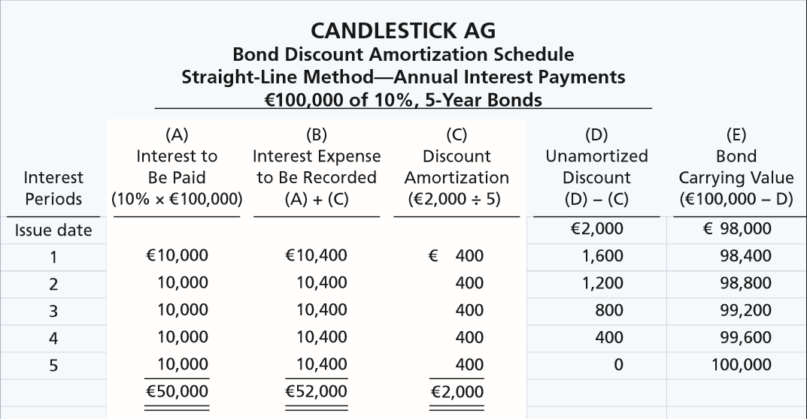
Amortizing Bond Discount
Illustration 10B-2
Bond discount amortization schedule
LO 10

Slide 73
Amortizing Bond Premium
Illustration: Candlestick, Inc., sold €100,000, five-year, 10% bonds on January 1, 2017, for €102,000 (premium of €2,000). Interest is payable on January 1 of each year. Prepare the entry to accrue interest and amortize the bond premium at Dec. 31, 2017.
Dec. 31
Interest Expense 9,600
Bonds Payable 400
Interest Payable 10,000
LO 10

Slide 74
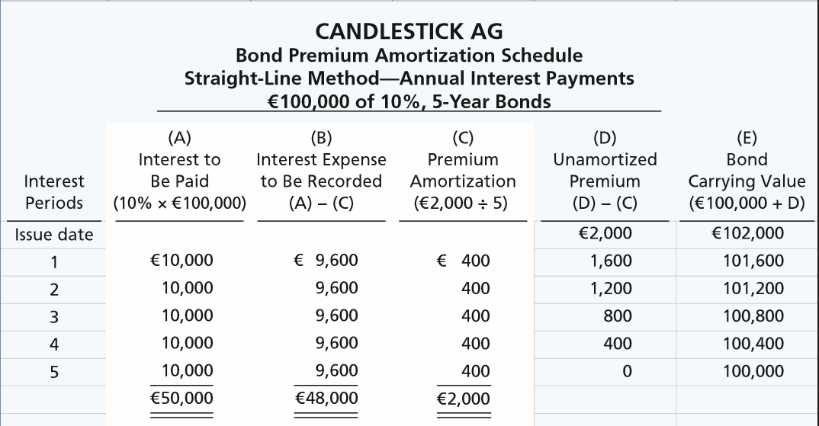
Amortizing Bond Premium
Illustration 10B-4
Bond premium amortization schedule
LO 10

Slide 75
APPENDIX 10C
Employee-Related Liabilities
Learning Objective 11
Identify types of employee-related liabilities.
The term “payroll” pertains to both:
Salaries - managerial, administrative, and
sales personnel (monthly or yearly rate).
Wages - store clerks, factory employees, and manual laborers (rate per hour).
Determining the payroll involves computing three amounts: (1) gross earnings, (2) payroll deductions, and (3) net pay.
LO 11

Slide 76
Payroll Deductions
Illustration 10C-1
Summary of payroll liabilities
LO 11

Slide 77
PAYROLL DEDUCTIONS EXAMPLE
Assume a weekly payroll of $10,000 entirely subject to Social Security taxes (8%), with income tax withholding of $1,320 and union dues of $88 deducted.
Salaries and Wages Expense 10,000
Withholding Taxes Payable 1,320
Social Security Taxes Payable 800
Union Dues Payable 88
Cash 7,792
Record the employer payroll taxes.
Payroll Tax Expense 800
Social Security Taxes Payable 800
LO 11

Slide 78
Profit-Sharing and Bonus Plans
Illustration: Palmer Inc. shows income for the year 2017 of $100,000. It will pay out bonuses of $10,700 in January 2018. Palmer makes an adjusting entry dated December 31, 2017, to record the bonuses as follows.
Salaries and Wages Expense 10,700
Salaries and Wages Payable 10,700
In January 2018, when Palmer pays the bonus, it makes this journal entry:
Salaries and Wages Payable 10,700
Cash 10,700
LO 11

Slide 79
A Look at U.S. GAAP
Learning Objective 12
Compare the accounting for liabilities under IFRS and U.S. GAAP.
Key Points
Similarities
The basic definition of a liability under GAAP and IFRS is very similar. Liabilities may be legally enforceable via a contract or law but need not be; that is, they can arise due to normal business practice or customs.
Both GAAP and IFRS classify liabilities as current or non-current on the face of the statement of financial position. IFRS specifically states, however, that industries where a presentation based on liquidity would be considered to provide more useful information (such as financial institutions) can use that format instead.
The basic calculation for bond valuation is the same under GAAP and IFRS. In addition, the accounting for bond liability transactions is essentially the same between GAAP and IFRS.
LO 12

Slide 80
A Look at U.S. GAAP
Key Points
Differences
Under IFRS, companies sometimes show liabilities before assets. Also, they will sometimes show non-current liabilities before current liabilities. Neither of these presentations is used under GAAP.
Under IFRS, companies sometimes will net current liabilities against current assets to show working capital on the face of the statement of financial position. This practice is not used under GAAP.
IFRS requires use of the effective-interest method for amortization of bond discounts and premiums. GAAP allows use of the straight-line method where the difference is not material.
GAAP often uses a separate discount or premium account to account for bonds payable. IFRS records discounts or premiums as direct increases or decreases to Bonds Payable.
LO 12

Slide 81
A Look at U.S. GAAP
Key Points
Differences
GAAP requires that the proceeds from the issuance of convertible debt be shown solely as debt. Unlike GAAP, IFRS splits the proceeds from the convertible bond between an equity component and a debt component. The equity conversion rights are reported in equity.
IFRS reserves the use of the term contingent liability to refer only to possible obligations that are not recognized in the financial statements but may be disclosed if certain criteria are met. Under GAAP, contingent liabilities are recorded in the financial statements if they are both probable and can be reasonably estimated. If only one of these criteria is met, then the item is disclosed in the notes.
IFRS uses the term provisions to refer to liabilities of uncertain timing or amount. Examples of provisions would be provisions for warranties, employee vacation pay, or anticipated losses. Under GAAP, these are considered recordable contingent liabilities.
LO 12

Slide 82
A Look at U.S. GAAP
Looking to the Future
The FASB and IASB are currently involved in two projects, each of which has implications for the accounting for liabilities. One project is investigating approaches to differentiate between debt and equity instruments. The other project, the elements phase of the conceptual framework project, will evaluate the definitions of the fundamental building blocks of accounting. The results of these projects could change the classification of many debt and equity securities.
LO 12

Slide 83
A Look at U.S. GAAP
A Look at IFRS
GAAP Self-Test Questions
Which of the following is false?
Under GAAP, current liabilities are presented before non-current liabilities.
Under GAAP, an item is a current liability if it will be paid within the next 12 months or the operating cycle, whichever is longer.
Under GAAP, current liabilities are shown in order of magnitude.
Under GAAP, a liability is only recognized if it is a present obligation.
LO 12

Slide 84
A Look at U.S. GAAP
A Look at IFRS
GAAP Self-Test Questions
The accounting for bonds payable is:
essentially the same under IFRS and GAAP.
different in that GAAP requires use of the straight-line method for amortization of bond premium and discount.
the same except that market prices may be different because the present value calculations are different between IFRS and GAAP.
not covered by IFRS.
LO 12

Slide 85
A Look at U.S. GAAP
A Look at IFRS
GAAP Self-Test Questions
Which of the following is true regarding accounting for amortization of bond discount and premium?
Both IFRS and GAAP must use the effective-interest method.
GAAP must use the effective-interest method, but IFRS may use either the effective-interest method or the straight-line method.
IFRS is required to use the effective-interest method.
GAAP is required to use the straight-line method.
LO 12

Slide 86
Copyright
“Copyright © 2016 John Wiley & Sons, Inc. All rights reserved. Reproduction or translation of this work beyond that permitted in Section 117 of the 1976 United States Copyright Act without the express written permission of the copyright owner is unlawful. Request for further information should be addressed to the Permissions Department, John Wiley & Sons, Inc. The purchaser may make back-up copies for his/her own use only and not for distribution or resale. The Publisher assumes no responsibility for errors, omissions, or damages, caused by the use of these programs or from the use of the information contained herein.”

